Slide 1
MongoDB Geospatial Queries
Olivier Liechti & Simon Oulevay
COMEM Web Services 2016

Slide 2
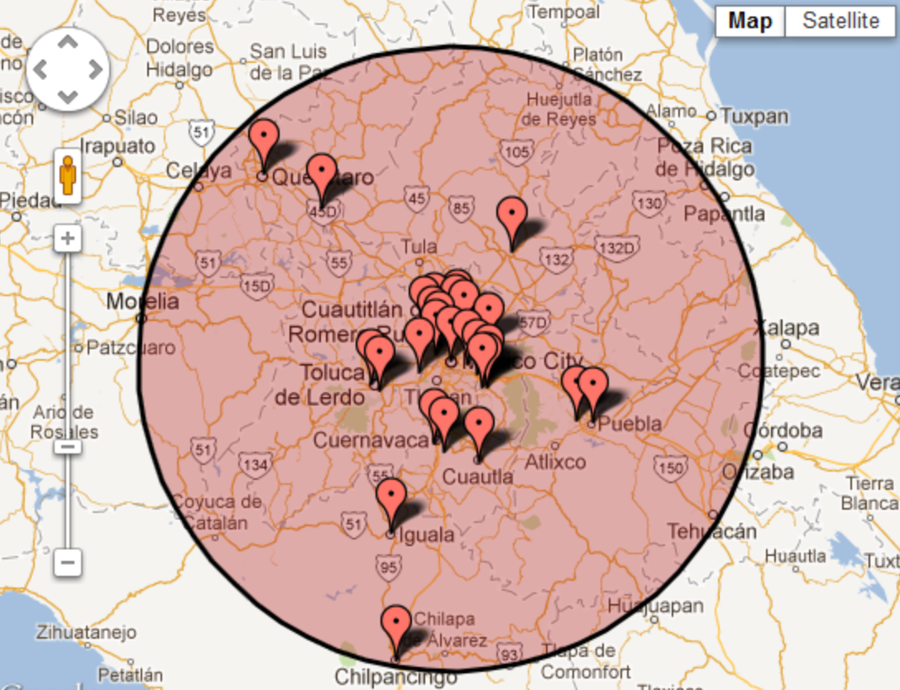
How do I make geospatial queries?

Slide 3
Storing geospatial data (1)
GeoJSON is a format for encoding a variety of geographic data structures.
{
"banner": "Starbucks",
"city": "Lausanne",
"location": {
"type": "Point",
"coordinates": [125.6, 10.1]
}
}
GeoJSON supports the following geometry types: Point, LineString, Polygon, MultiPoint, MultiLineString, and MultiPolygon.

Slide 4
Storing geospatial data (2)
To be able to execute geospatial queries on this data, you must add a MongoDB geospatial index.
var ShopSchema = new Schema({
banner: String,
city: String,
location: {
type: { type: String },
coordinates: [Number]
}
});
ShopSchema.index({
location: '2dsphere'
});
Add the GeoJSON data to your schema.
Add a 2dsphere index on that property.
https://docs.mongodb.org/manual/applications/geospatial-indexes/

Slide 5
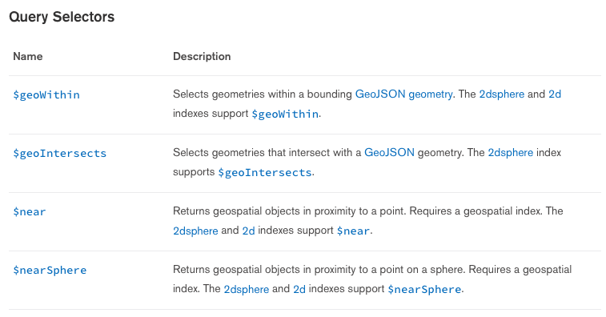
Making geospatial queries (1)
MongoDB supports several geospatial query operators.
https://docs.mongodb.org/manual/reference/operator/query-geospatial/

Slide 6
Making geospatial queries (2)
router.get('/', function(req, res, next) {
var criteria = {};
var latitude = req.query.latitude,
longitude = req.query.longitude,
distance = req.query.distance;
if (latitude && longitude && distance) {
criteria.location = {
$near: {
$geometry: {
type: 'Point',
coordinates: [
parseFloat(longitude),
parseFloat(latitude)
]
},
$maxDistance: parseInt(distance, 10)
}
};
}
Shop.find(criteria, function(err, shops) {
// ...
});
});
Define what query parameters API users should provide. Here we expect a latitude, longitude and a distance (in meters).
Here, we use the $near operator to find all shops within the specified distance to the specified point.
Note that the $geometry argument to the $near operator is itself a GeoJSON object.
Then simply pass the criteria to find, as we did before.

